Slide 1
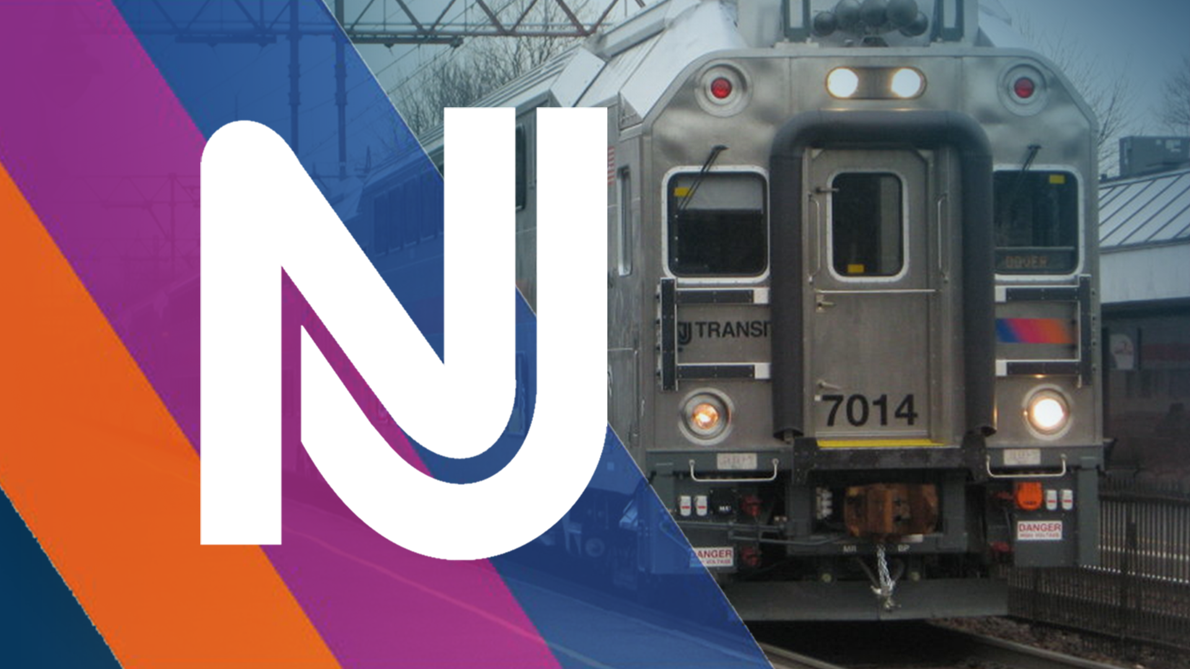
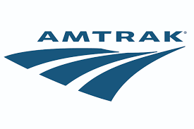
Unstructured Data Management:
NJ Transit + Amtrak (NEC)
By: Marist Ratanavong, Matson Anderson, Alatta Lawrence, Aditya Saxena, Emma Berman

Slide 2
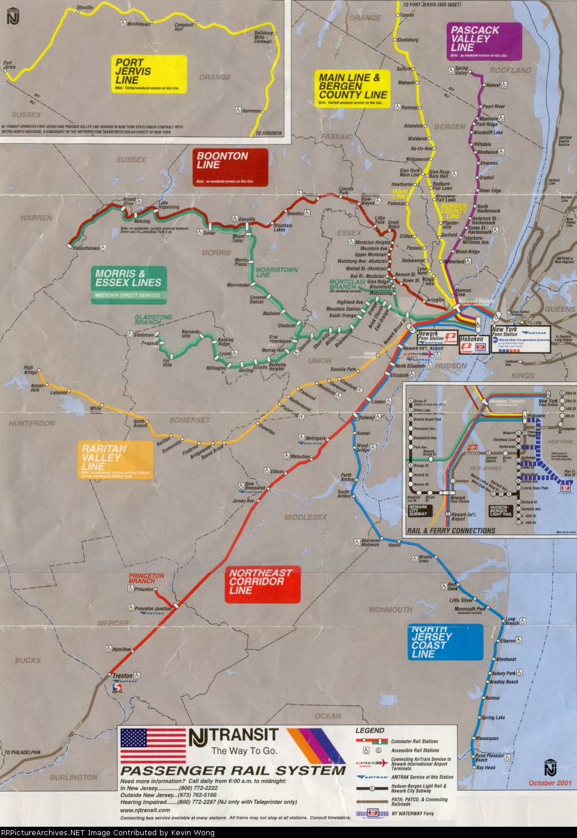
Background
The Northeast Corridor is most travelled rail corridor in the United States.
Minor interferences lead to major backups.
There are many delays on the corridor.

Slide 3
Objective
To provide alternative routing for passengers
Determine which stops cause the most delays
Ease congestion
Allow for better connections for faster commutes
Determine areas of extreme delays for potential improvement

Slide 4

Problem Statement:
How can you use train time delays to determine better alternatives for passengers to increase customer satisfaction?

Slide 5
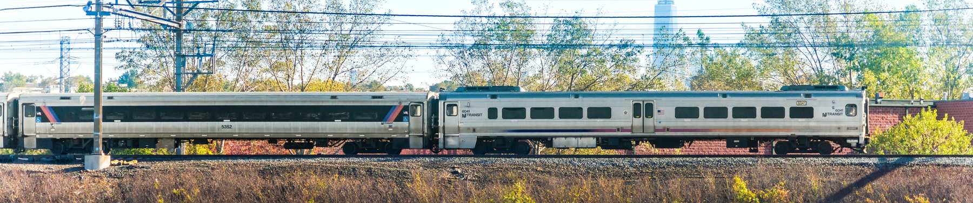
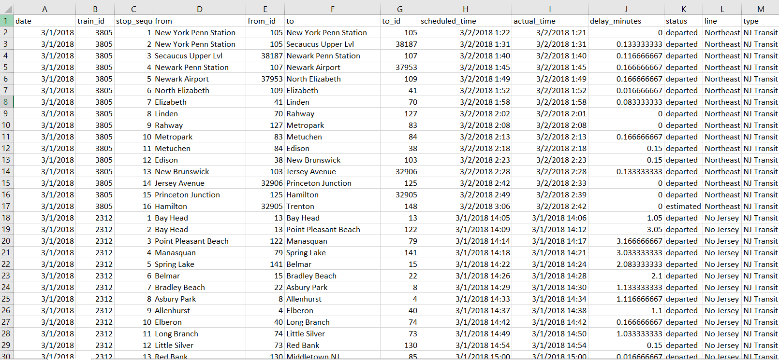
Kaggle
NJ Transit + Amtrak Rail Performance
Train IDs
Number of stops
From + To Location
# of delayed minutes

Slide 6
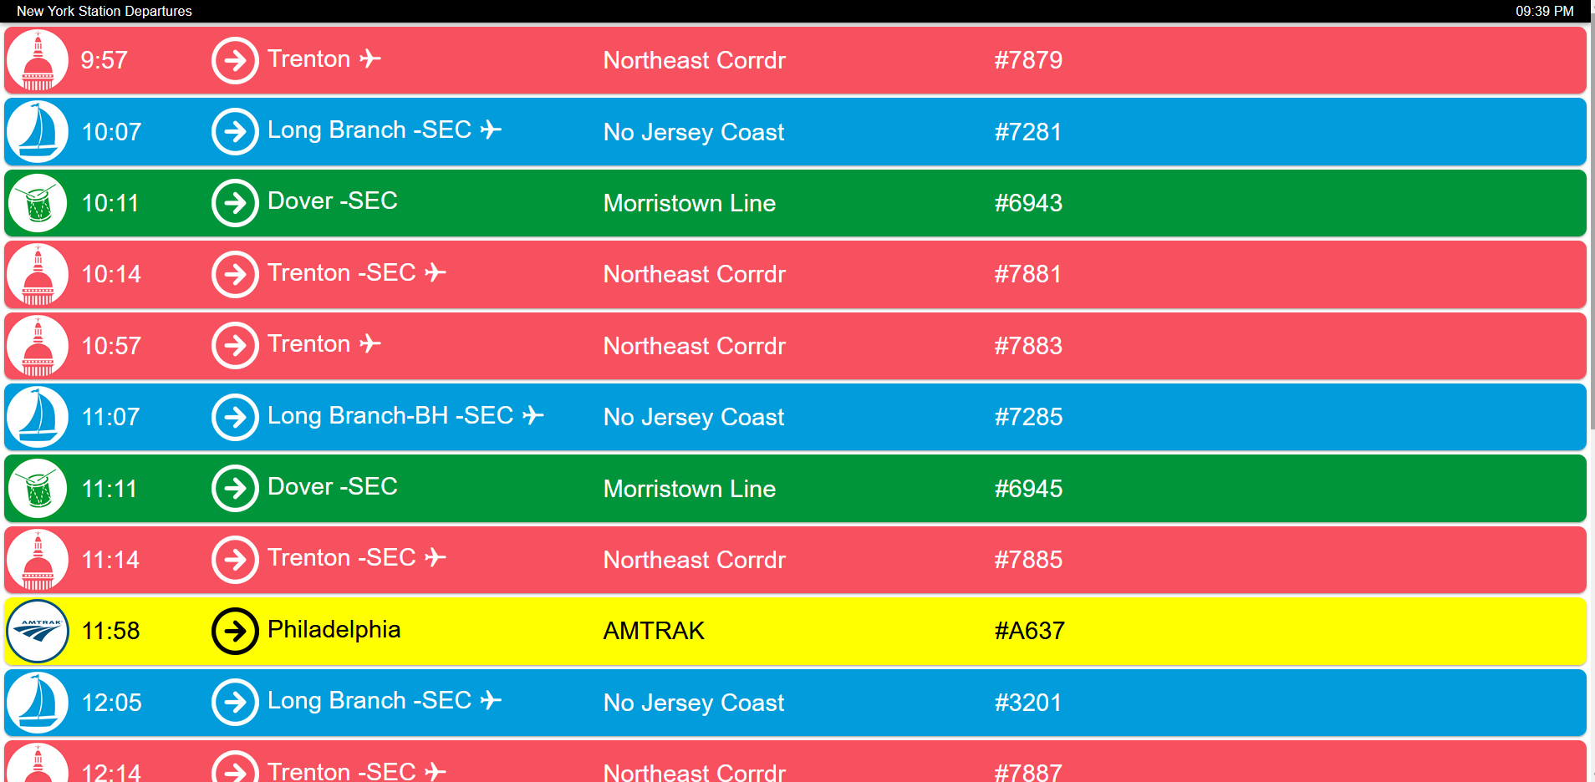
Departure Vision
Operated by NJT
Departure and Arrival time
Line Name
Real Time

Slide 7
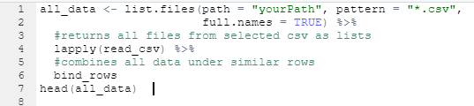
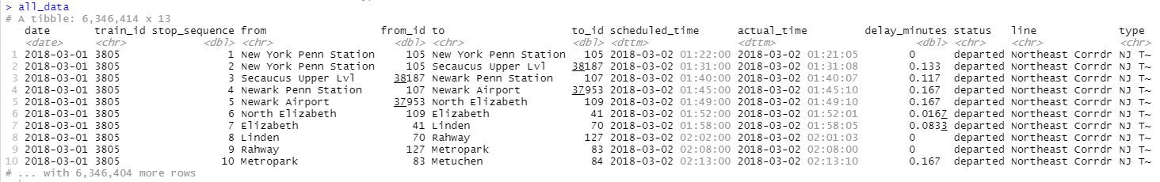
Initial Code
Used Rstudio to filter data
CSV files were made by month
Initially sorted by train_id
Millions of rows of data when combined
Notes:
Like most of the other teams in the class we used RStudio to filter our data.
With our focus pinpoint on customer satisfaction as far as reducing their time delays in going to work, school or other important events through the train system, we needed to analyze delayed times in minutes from the data and figure out what causes them to increase and decrease.
As we are not train experts, our natural instincts led us to believe that for delays to happen, it must be a ripple effect of something that happened before the train to get to a particular stop.
The dataset captured in Kaggle contained 29 different csv files. We started to look at the individual files that had monthly delays to see which trains had the most delays and the stop sequence or number of stops.
We soon came to realize that it took a great deal of time looking at which train lines had the most delayed times and stop sequences and beyond that we still must compare every single month with each other. Because of this, we decided to combine all the monthly data captured so that it was easier to compare the delay times and stop sequences over the two plus year period.
This is code that we used. Using tidyverse and a few other packages to return the files as lists and combine the similar rows, which they all had.

Slide 8
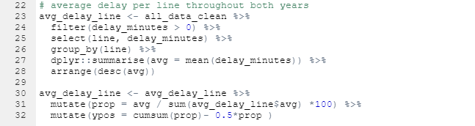
Line Delay Filtering
Use RStudio to determine average delay of all lines
Sorted by delay time
2 year period
Notes:
Once that has been completed, the second code here was generated to look at those average delays of all lines, which were sorted over the 2+ years.
As shown in the code, we filtered the delayed times and selected the lines that matched. We then grouped the results by the transit line because we wanted to know the line with the highest delays, summarized the mean/average delayed time and arrange from largest to smallest.
We then generated two new variables to prop and ypos to capture what percentage of the average each transit line had and calculating the cumulative sum and positioning the text on the pie chart.

Slide 9
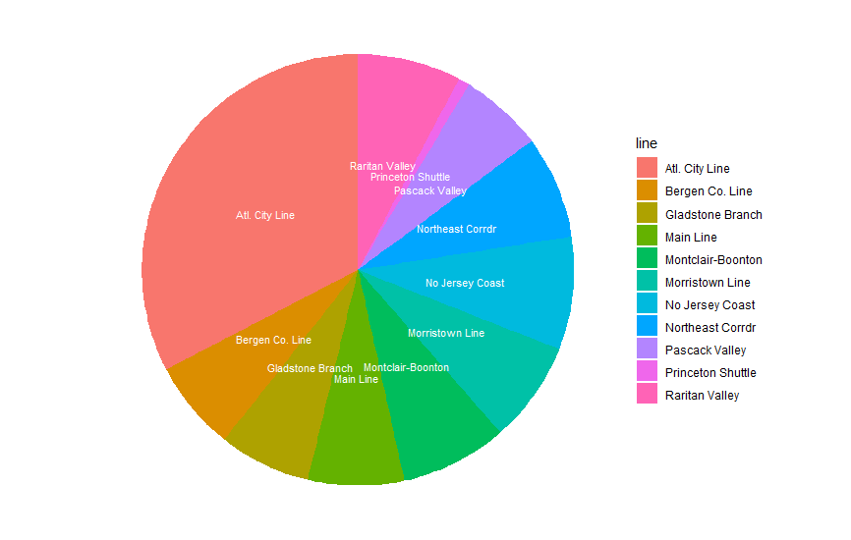
Lines with the Longest Delays
Atlantic City Line longest with 20.3 minutes of delay. (9 stops)
Second longest is New Jersey Coast Line (26 stops)
Notes:
Adi

Slide 10
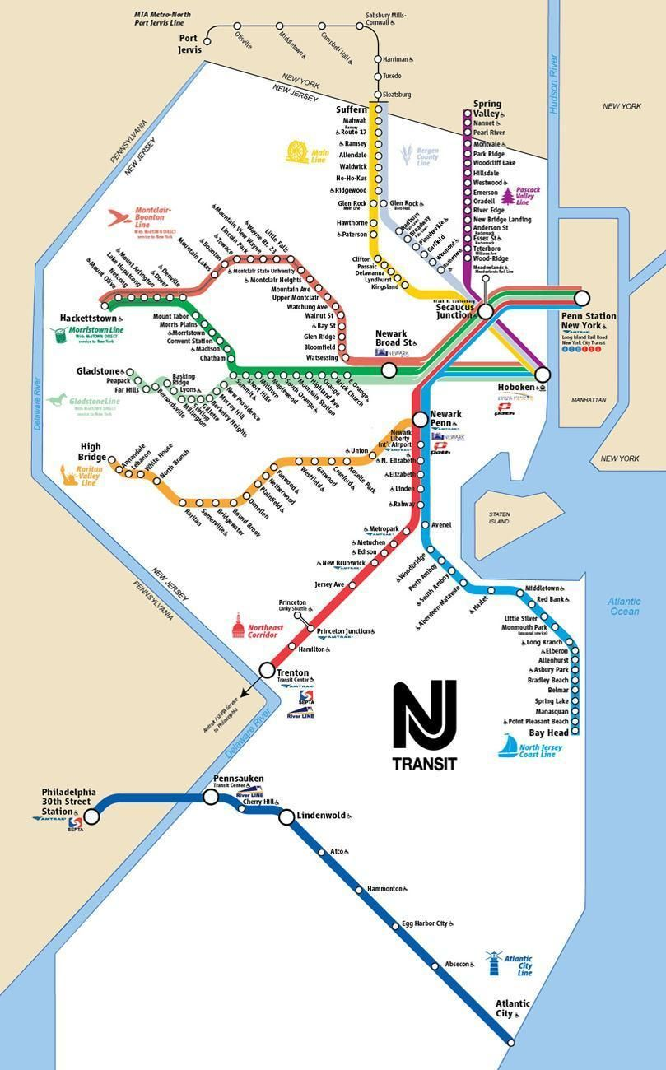
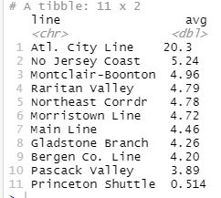
Line Findings
North Jersey Coast Line (26 stops) has the second highest number of delays.
Atlantic City Line had the highest amount of delay totaling 20.3 minutes on average through 2018 - 2019. It does travel into Philadelphia.
Notes:
Adi

Slide 11
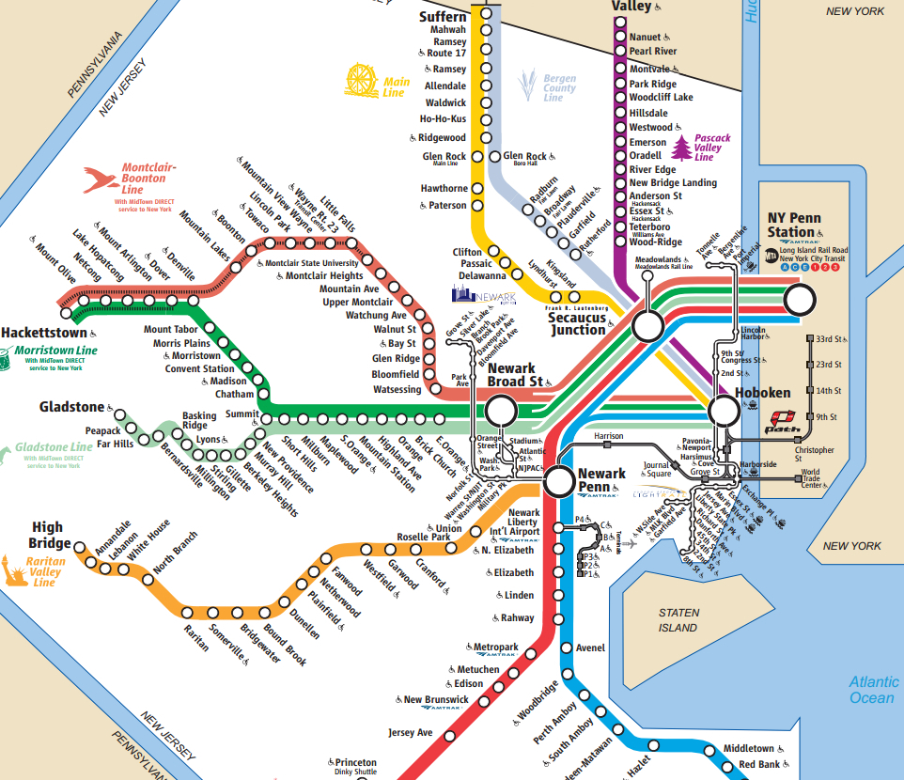
Analysis
Reduce the number of lines running the same stops:
Morristown/ Montclair-Boonton Line (7 shared stops)
Main Line / Bergen Line (8 shared stops)
Notes:
Matson

Slide 12
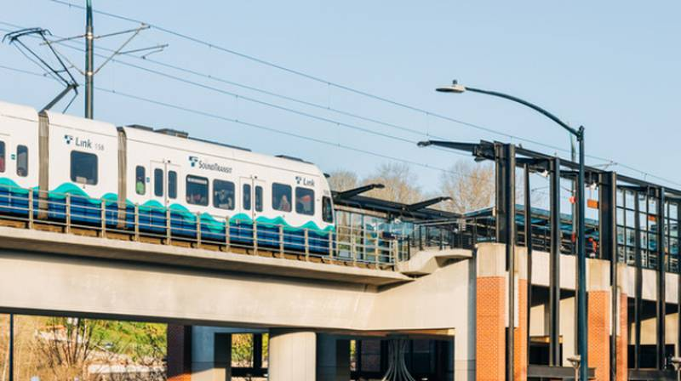
Recommendation
Reduce the amount of stops/ unnecessary stops
Saves time
Reduce congestion
Can save money in operations
Combine shared stops into one line.
Reduce number of trains on line
Speeds up process
Reduce delay if incident occurs
Notes:
Matson

Slide 13

Thank You for your attention.
Any questions?

